Slide 1
第7章 RPC框架
cxiao@fudan.edu.cn

Slide 2
提纲
RPC框架概述
框架的客户端设计
框架的服务端设计
服务消费者
服务发布者

Slide 3
RPC框架概述

Slide 5
RPC的操作流程
客户端调用RPC本地代理，就像调用本地方法一样，传递参数；
本地代理把调用的方法名、参数值等信息编组为消息，向服务端发送；
服务端接收到消息后将其解组为方法名、参数值等；
服务端调用自身的服务实例的方法，传入参数，得到结果
服务端以反方向的相同步骤将结果响应给客户端。

Slide 6
1 @Data
2 public class Request implements Serializable {
3 private String serviceName;
4 private String version;
5 private String method;
6 private Map<String, String> headers = new HashMap<String, String>();
7 private Class<?>[ ] prameterTypes;
8 private Object[ ] parameters;
9 public String getHeader(String name) {
10 return this.headers == null ? null : this.headers.get(name);
11 }
12 public void setHeader(String key, String value){
13 this.headers.put(key, value);
14 }
15 }

Slide 7
1 @Data
2 public class Response implements Serializable {
3 private Map<String, String> headers = new HashMap<>();
4 private Status status;
5 private Object returnValue;
6 private Exception exception;
7 public Response() { }
8 public Response(Status status) {
9 this.status = status;
10 }
11 public String getHeader(String name) {
12 return this.headers == null ? null : this.headers.get(name);
13 }
14 public void setHeader(String key, String value) {
15 this.headers.put(key, value);
16 }
17 }

Slide 8
框架的客户端设计

Slide 9
框架的客户端设计
序列化器
代理层
通信层

Slide 10
客户端依赖
1 <dependencies>
2 <dependency>
3 <groupId>com.thoughtworks.xstream</groupId>
4 <artifactId>xstream</artifactId>
5 <version>1.4.12</version>
6 </dependency>
7 <dependency>
8 <groupId>io.netty</groupId>
9 <artifactId>netty-all</artifactId>
10 <version>4.1.51.Final</version>
11 </dependency>
12 <dependency>
13 <groupId>org.projectlombok</groupId>
14 <artifactId>lombok</artifactId>
15 <version>1.18.12</version>
16 </dependency>
17 </dependencies>

Slide 11
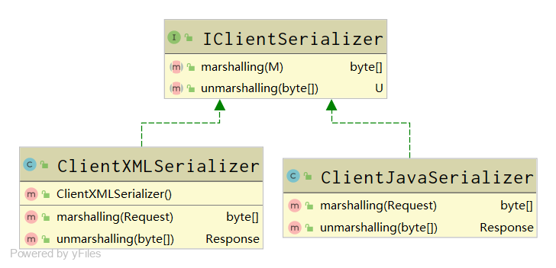
1 public interface IClientSerializer<M, U> {
2 //把第一个泛型M序列化，把第二个泛型U反序列化
3 byte[ ] marshalling(M t) throws Exception;
4 U unmarshalling(byte[ ] data) throws Exception;
5 }
序列化器

Slide 12
1 public class ClientJavaSerializer implements IClientSerializer<Request, Response>{
2 @Override
3 public byte[ ] marshalling(Request request) throws Exception {
4 return objSerializableToByteArray(request);
5 }
6 @Override
7 public Response unmarshalling(byte[ ] data) throws Exception {
8 return (Response) byteArrayToObjSerializable(data);
9 }
10 //反序列化，将字节转化成对象，Object必须实现Serializable接口
11 private static Object byteArrayToObjSerializable(byte[ ] bytes) throws Exception{
12 ByteArrayInputStream byteArrayInputStream = new ByteArrayInputStream(bytes);
13 ObjectInputStream objectInputStream = new ObjectInputStream(byteArrayInputStream);
14 Object obj = objectInputStream.readObject();
15 objectInputStream.close();
16 byteArrayInputStream.close();
17 return obj;
18 }
19 //序列化，将对象转化成字节，Object必须实现Serializable接口
20 private static byte[ ] objSerializableToByteArray(Object objSerializable) throws Exception{
21 ByteArrayOutputStream byteArrayOutputStream = new ByteArrayOutputStream();
22 ObjectOutputStream objectOutputStream = new ObjectOutputStream(byteArrayOutputStream);
23 objectOutputStream.writeObject(objSerializable);
24 byte[ ] bytes = byteArrayOutputStream.toByteArray();
25 objectOutputStream.close();
26 byteArrayOutputStream.close();
27 return bytes;
28 }
29 }

Slide 13
1 public class ClientXMLSerializer implements IClientSerializer<Request, Response> {
2 private XStream xStream;
3 public ClientXMLSerializer(){
4 xStream = new XStream();
5 xStream.alias(Request.class.getSimpleName(), Request.class);
6 xStream.alias(Response.class.getSimpleName(), Response.class);
7 }
8 @Override
9 public byte[ ] marshalling(Request request) throws Exception {
10 String xml = xStream.toXML(request);
11 return xml.getBytes("utf-8");
12 }
13 @Override
14 public Response unmarshalling(byte[ ] data) throws Exception {
15 String xml = new String(data, "utf-8");
16 return (Response) xStream.fromXML(xml);
17 }
18 }

Slide 14
1 @Data
2 public class ClientStubProxyFactory {
3 private ServiceInfoDiscoverer sid;
4 private NetClient<Request,Response> netClient;
5 private Map<String, IClientSerializer<Request,Response>> supportingSerializers;
6 //key的形式为 interfName:version
7 private Map<String, Object> proxyCache = new HashMap<>();
8 public <T> T getProxy(Class<T> interf, String version) {
9 String key = interf.getName() + ":" + version;
10 T obj = (T) this.proxyCache.get(key);
11 if (obj == null) {
12 obj = (T) Proxy.newProxyInstance(interf.getClassLoader(),
13 new Class<?>[ ] { interf },
14 new ClientStubInvocationHandler(interf, version));
15 this.proxyCache.put(key, obj);
16 }
17 return obj;
}
19 private class ClientStubInvocationHandler implements InvocationHandler {
20 private Class<?> interf;
21 private String version;
22 public ClientStubInvocationHandler(Class<?> interf, String version) {
23 super();
24 this.interf = interf;
25 this.version = version;
26 }
代理层

Slide 15
27 @Override
28 public Object invoke(Object proxy, Method method, Object[ ] args) throws Throwable {
29 if (method.getName().equals("toString")) {
30 return proxy.getClass().toString();
31 }
32 if (method.getName().equals("hashCode")) {
33 return 0;
34 }
35 // 1. 获得服务信息
36 String serviceName = this.interf.getName();
37 List<ServiceInfo> sinfos = sid.getServiceInfo(serviceName, this.version);
38 if (sinfos == null || sinfos.size() == 0) {
39 throw new Exception("远程服务不存在！");
40 }
41 // 2. 随机选择一个服务提供者（软负载均衡）
42 ServiceInfo sinfo = sinfos.get(new Random().nextInt(sinfos.size()));
43 // 3. 构造Request对象
44 Request req = new Request();
45 req.setServiceName(sinfo.getInterfName());
46 req.setMethod(method.getName());
47 req.setPrameterTypes(method.getParameterTypes());
48 req.setParameters(args);
49 req.setVersion(sinfo.getVersion());
50 // 4. 获得对应的序列化器
51 IClientSerializer<Request, Response> serializing = supportingSerializers.get(sinfo.getSerializingType());
52 // 5. 发送请求并得到应答
53 Response rsp = netClient.sendRequest(req, sinfo.getAddress(), serializing);
54 if (rsp.getException() != null) {
55 throw rsp.getException();
56 }
57 return rsp.getReturnValue();
58 }
59 }
60 }

Slide 16
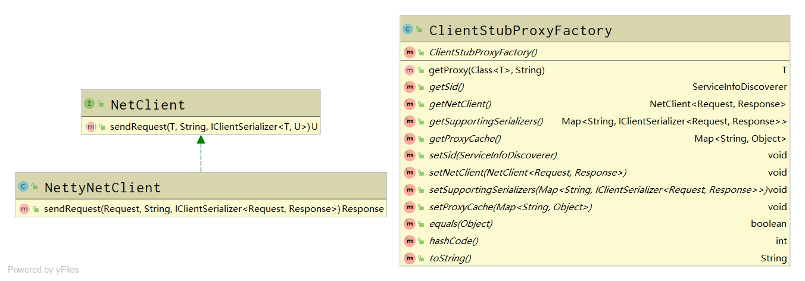
通信层
1 public interface NetClient<T, U> {
2 U sendRequest(T request, String sAddress, IClientSerializer<T, U> serializing) throws Throwable;
3 }

Slide 17
1 public class NettyNetClient implements NetClient<Request, Response> {
2 @Override
3 public Response sendRequest(Request request, String sAddress, IClientSerializer<Request, Response> serializing) throws Throwable {
4 String[ ] addInfoArray = sAddress.split(":"); // sAddress为ip:port格式
5 SendHandler<Request, Response> sendHandler = new SendHandler<>(request, serializing);
6 Response response = null;
7 // 配置Netty客户端
8 EventLoopGroup group = new NioEventLoopGroup();
9 try {
10 Bootstrap b = new Bootstrap();
11 b.group(group)
12 .channel(NioSocketChannel.class)
13 .remoteAddress(new InetSocketAddress(addInfoArray[0], Integer.valueOf(addInfoArray[1])))
14 .option(ChannelOption.TCP_NODELAY, true)
15 .handler(new ChannelInitializer<SocketChannel>() {
16 @Override
17 public void initChannel(SocketChannel ch) throws Exception {
18 ch.pipeline().addLast(new LengthFieldBasedFrameDecoder(Integer.MAX_VALUE, 0, 4, 0, 4));
19 ch.pipeline().addLast(sendHandler);
20 ch.pipeline().addLast(new AttachHeaderHandler());
21 }
22 });
23 // 启动Netty客户端连接
24 b.connect().sync();
25 response = sendHandler.getResponse();
26 } finally {
27 // 释放线程组资源
28 group.shutdownGracefully();
29 }
30 return response;
31 }

Slide 18
32 //T是最初发送出去的类型，U是最后接收到的类型
33 private class SendHandler<T, U> extends ChannelInboundHandlerAdapter {
34 private T request;
35 private U response = null;
36 private IClientSerializer<T, U> serializing;
37 private CountDownLatch cdl;
38 public SendHandler(T request, IClientSerializer<T, U> serializing) {
39 cdl = new CountDownLatch(1);
40 this.request = request;
41 this.serializing = serializing;
42 }
43 @Override
44 public void channelActive(ChannelHandlerContext ctx) throws Exception {
45 byte[ ] data = this.serializing.marshalling(this.request);
46 ByteBuf reqBuf = Unpooled.buffer(data.length);
47 reqBuf.writeBytes(data);
48 ctx.channel().write(reqBuf);
49 }
50 public U getResponse() {
51 try {
52 cdl.await();
53 } catch (InterruptedException e) {
54 e.printStackTrace();
55 }
56 return this.response;
57 }
58 @Override
59 public void channelRead(ChannelHandlerContext ctx, Object msg) throws Exception {
60 ByteBuf msgBuf = (ByteBuf) msg;
61 byte[ ] bytes = new byte[msgBuf.readableBytes()];
62 msgBuf.readBytes(bytes);
63 this.response = this.serializing.unmarshalling(bytes);
64 cdl.countDown();
65 }
66 @Override
67 public void exceptionCaught(ChannelHandlerContext ctx, Throwable cause) {
68 cause.printStackTrace();
69 ctx.close();
70 }
71 }
72 }

Slide 19
框架的服务端设计

Slide 20
框架的服务端设计
序列化器
反射层
通信层

Slide 21
服务端依赖
1 <dependencies>
2 <dependency>
3 <groupId>com.thoughtworks.xstream</groupId>
4 <artifactId>xstream</artifactId>
5 <version>1.4.12</version>
6 </dependency>
7 <dependency>
8 <groupId>io.netty</groupId>
9 <artifactId>netty-all</artifactId>
10 <version>4.1.51.Final</version>
11 </dependency>
12 <dependency>
13 <groupId>org.projectlombok</groupId>
14 <artifactId>lombok</artifactId>
15 <version>1.18.12</version>
16 </dependency>
17 </dependencies>

Slide 22
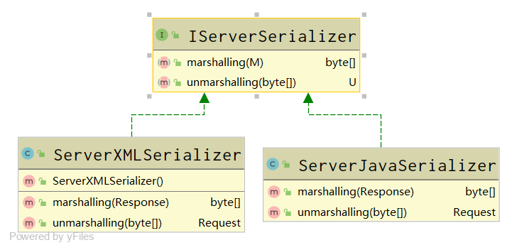
序列化器
1 public interface IServerSerializer<U, M> {
2 //把第一个泛型U反序列化，把第二个泛型M序列化
3 byte[ ] marshalling(M m) throws Exception;
4 U unmarshalling(byte[ ] data) throws Exception;
5 }

Slide 23
1 public class ServerJavaSerializer implements IServerSerializer<Request, Response> {
2 @Override
3 public byte[ ] marshalling(Response response) throws Exception {
4 return objSerializableToByteArray(response);
5 }
6 @Override
7 public Request unmarshalling(byte[ ] data) throws Exception {
8 return (Request)byteArrayToObjSerializable(data);
9 }
10 //反序列化，将字节转化成对象，Object必须实现Serializable接口
11 private static Object byteArrayToObjSerializable(byte[ ] bytes) throws Exception{
12 ByteArrayInputStream byteArrayInputStream = new ByteArrayInputStream(bytes);
13 ObjectInputStream objectInputStream = new ObjectInputStream(byteArrayInputStream);
14 Object obj = objectInputStream.readObject();
15 objectInputStream.close();
16 byteArrayInputStream.close();
17 return obj;
18 }
19 //序列化，将对象转化成字节，Object必须实现Serializable接口
20 private static byte[ ] objSerializableToByteArray(Object objSerializable) throws Exception{
21 ByteArrayOutputStream byteArrayOutputStream = new ByteArrayOutputStream();
22 ObjectOutputStream objectOutputStream = new ObjectOutputStream(byteArrayOutputStream);
23 objectOutputStream.writeObject(objSerializable);
24 byte[ ] bytes = byteArrayOutputStream.toByteArray();
25 objectOutputStream.close();
26 byteArrayOutputStream.close();
27 return bytes;
28 }
29 }

Slide 24
1 public class ServerXMLSerializer implements IServerSerializer<Request, Response> {
2 private XStream xStream;
3 public ServerXMLSerializer(){
4 xStream = new XStream();
5 xStream.alias(Request.class.getSimpleName(), Request.class);
6 xStream.alias(Response.class.getSimpleName(), Response.class);
7 }
8 @Override
9 public byte[ ] marshalling(Response response) throws Exception {
10 String xml = xStream.toXML(response);
11 return xml.getBytes("utf-8");
12 }
13 @Override
14 public Request unmarshalling(byte[ ] data) throws Exception {
15 String xml = new String(data, "utf-8");
16 return (Request) xStream.fromXML(xml);
17 }
18 }

Slide 25
1 @Data
2 @AllArgsConstructor
3 public class RequestHandler{
4 private ServiceRegister serviceRegister;
5 public Response handleRequest(Request req) throws Exception{
6 System.out.println("req=" + req);
7 // 查找服务对象
8 ServiceObject so = this.serviceRegister.getServiceObject(req.getServiceName(), req.getVersion());
9 System.out.println(so);
10 Response rsp = null;
11 if (so == null) {
12 rsp = new Response(Status.NOT_FOUND);
13 } else {
14 // 反射调用对应的过程方法
15 try {
16 Method m = so.getInterf().getMethod(req.getMethod(), req.getPrameterTypes());
17 Object returnValue = m.invoke(so.getObj(), req.getParameters());
18 rsp = new Response(Status.SUCCESS);
19 rsp.setReturnValue(returnValue);
20 } catch (NoSuchMethodException | SecurityException | IllegalAccessException | IllegalArgumentException |
InvocationTargetException e) {
21 rsp = new Response(Status.ERROR);
22 rsp.setException(e);
23 }
24 }
25 return rsp;
26 }
27 }
反射层

Slide 26
服务注册功能(模拟)
1 public class ServiceRegister {
2 private ConcurrentLinkedQueue<ServiceObject> serviceDB = new ConcurrentLinkedQueue<>();
3 public void register(ServiceObject so, String protocol, int port) throws Exception{
4 if (so == null){
5 throw new IllegalArgumentException("参数不能为空！");
6 }
7 this.serviceDB.add(so);
8 // 参数protocol 与 port 在真正注册时使用，这里不作注册。
9 }
10 public ServiceObject getServiceObject(String interfName, String version){
11 for(ServiceObject so:serviceDB){
12 if (so.getInterf().getName().equals(interfName) && so.getVerseion().equals(version)){
13 return so;
14 }
15 }
16 return null;
17 }
18 }
1 @Data
2 @AllArgsConstructor
3 public class ServiceObject {
4 // interf 和 version 构成联合主键
5 private Class<?> interf;
6 private String verseion;
7 private Object obj;
8 }

Slide 27
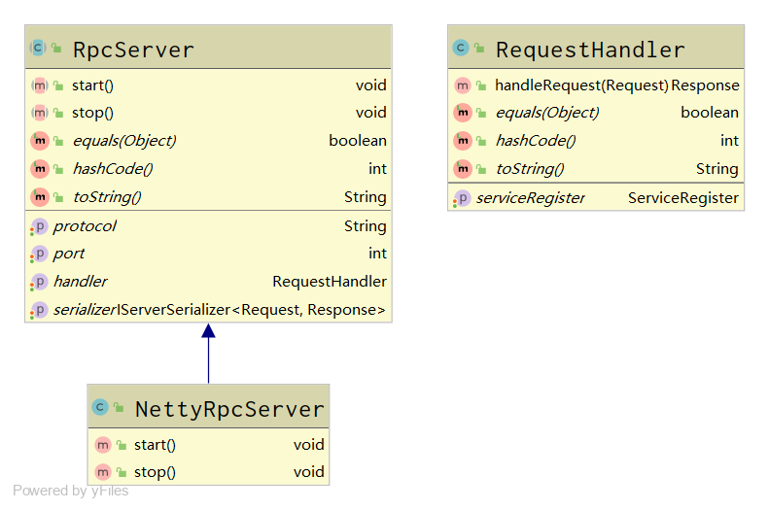
通信层
1 @Data
2 @AllArgsConstructor
3 public abstract class RpcServer {
4 protected int port;
5 protected String protocol;
6 protected RequestHandler handler;
7 protected IServerSerializer<Request, Response> serializer;
8 //启动服务
9 public abstract void start();
10 //停止服务
11 public abstract void stop();
12 }

Slide 28
1 public class NettyRpcServer extends RpcServer {
2 public NettyRpcServer(int port, String protocol, RequestHandler handler, IServerSerializer<Request, Response> serializer) {
3 super(port, protocol, handler, serializer);
4 }
5 private Channel channel;
6 @Override
7 public void start() {
8 RecvHandler recvHandler = new RecvHandler(this.handler, this.serializer);
9 // 配置服务器
10 EventLoopGroup bossGroup = new NioEventLoopGroup(1);
11 EventLoopGroup workerGroup = new NioEventLoopGroup();
12 try {
13 ServerBootstrap b = new ServerBootstrap();
14 b.group(bossGroup, workerGroup)
15 .channel(NioServerSocketChannel.class)
16 .localAddress(new InetSocketAddress(port))
17 .option(ChannelOption.SO_BACKLOG, 100)
18 .childHandler(new ChannelInitializer<SocketChannel>() {
19 @Override
20 public void initChannel(SocketChannel ch) throws Exception {
21 ch.pipeline().addLast(new LengthFieldBasedFrameDecoder(Integer.MAX_VALUE, 0, 4, 0, 4));
22 ch.pipeline().addLast(recvHandler);
23 ch.pipeline().addLast(new AttachHeaderHandler());
24 }
25 });
26 // 启动服务
27 ChannelFuture f = b.bind().sync();
28 System.out.println("完成服务端端口绑定与启动...");
29 this.channel = f.channel();
30 // 等待服务通道关闭
31 f.channel().closeFuture().sync();
32 } catch (Exception e) {
33 e.printStackTrace();
34 } finally {
35 // 释放线程组资源
36 bossGroup.shutdownGracefully();
37 workerGroup.shutdownGracefully();
38 }
39 }

Slide 29
40 @Override
41 public void stop() {
42 this.channel.close();
43 }
44 @ChannelHandler.Sharable
45 private class RecvHandler extends ChannelInboundHandlerAdapter {
46 private RequestHandler handler;
47 private IServerSerializer<Request, Response> serializer;
48 public RecvHandler(RequestHandler handler, IServerSerializer<Request, Response> serializer){
49 this.handler = handler;
50 this.serializer = serializer;
51 }
52 @Override
53 public void channelRead(ChannelHandlerContext ctx, Object msg) throws Exception {
54 ByteBuf msgBuf = (ByteBuf) msg;
55 byte[ ] reqBytes = new byte[msgBuf.readableBytes()];
56 msgBuf.readBytes(reqBytes);
57 Request request = this.serializer.unmarshalling(reqBytes);
58 Response response = this.handler.handleRequest(request);
59 byte[ ] rspBytes = this.serializer.marshalling(response);
60 ByteBuf rspBuf = Unpooled.buffer(rspBytes.length);
61 rspBuf.writeBytes(rspBytes);
62 ctx.channel().write(rspBuf);
63 }
64 @Override
65 public void exceptionCaught(ChannelHandlerContext ctx, Throwable cause) {
66 cause.printStackTrace();
67 ctx.close();
68 }
69 }
70 }

Slide 30
服务消费者

Slide 31
要消费的服务接口
1 public interface HelloInterface {
2 String sayHello(String name);
3 Point multiPoint(Point p, int multi);
4 }
1 public interface StudentInterface {
2 List<Student> getAll();
3 Student getOne(Integer id);
4 boolean modifyStudent(Student student);
5 boolean eraseStudent(Integer id);
6 Student createStudent(Student student);
7 }

Slide 32
1 public class DefaultServiceInfoDiscovery implements ServiceInfoDiscoverer {
2 static String serializingType = PropertiesUtils.getProperties("rpc.serializing");
3 static String address = "127.0.0.1:" + PropertiesUtils.getProperties("rpc.port");
4 static List<ServiceInfo> serviceDB = Arrays.asList(
5 new ServiceInfo("cxiao.sh.cn.common.business.HelloInterface", "1.0", address, serializingType),
6 new ServiceInfo(“cxiao.sh.cn.common.business.HelloInterface”, "2.0", address, serializingType),
7 new ServiceInfo("cxiao.sh.cn.common.business.HelloInterface", "3.0", address, serializingType),
8 new ServiceInfo("cxiao.sh.cn.common.business.StudentInterface", "1.0", address, serializingType)
9 );
10 @Override
11 public List<ServiceInfo> getServiceInfo(String interfName, String version) {
12 List<ServiceInfo> list = new ArrayList<>();
13 for(ServiceInfo sInfo : serviceDB){
14 if (sInfo.getInterfName().equals(interfName) && sInfo.getVersion().equals(version)){
15 list.add(sInfo);
16 }
17 }
18 return list;
19 }
20 }
服务发现（模拟）
1 @Data
2 @AllArgsConstructor
3 @NoArgsConstructor
4 public class ServiceInfo {
5 // 因为服务信息来自注册中心，所以这里必须用字符串，不能用Class<?>
6 // interfName 与 version 构成联合主键
7 private String interfName;
8 private String version;
9 private String address; // ip:port的格式
10 private String serializingType;
11 }

Slide 33
1 public class Consumer {
2 public static void main(String[ ] args) {
3 ClientStubProxyFactory cspf = new ClientStubProxyFactory();
4 // 设置模拟的服务发现者，创建所支持的全部序列化器
5 cspf.setSid(new DefaultServiceInfoDiscovery());
6 Map<String, IClientSerializer<Request, Response>> supportingSerializers = new HashMap<>();
7 supportingSerializers.put("javas", new ClientJavaSerializer());
8 supportingSerializers.put("xml", new ClientXMLSerializer());
9 cspf.setSupportingSerializers(supportingSerializers);
10 // 设置网络层实现
11 cspf.setNetClient(new NettyNetClient());
12 // 获取远程服务的代理
13 HelloInterface hello = cspf.getProxy(HelloInterface.class, "2.0");
14 // 像调用本地方法一样执行远程方法
15 String msg = hello.sayHello("World!");
16 System.out.println(msg);
17 System.out.println(hello.multiPoint(new Point(5,10), 2));
18 StudentInterface stUtils = cspf.getProxy(StudentInterface.class, "1.0");
19 System.out.println(stUtils.getAll());
20 System.out.println(stUtils.getOne(102));
21 }
22 }
消费服务

Slide 34
服务发布者

Slide 35
1 public class Provider {
2 public static void main(String[ ] args) throws Exception {
3 //所有的对象用相同的port
4 int port = Integer.parseInt(PropertiesUtils.getProperties("rpc.port"));
5 String serializingType = PropertiesUtils.getProperties("rpc.serializing");
6 // 服务注册（模拟）
7 ServiceRegister sr = new ServiceRegister();
8 List<ServiceObject> objects = Arrays.asList(
9 new ServiceObject(HelloInterface.class, "1.0", new HelloService1()),
10 new ServiceObject(HelloInterface.class, "2.0", new HelloService2()),
11 new ServiceObject(HelloInterface.class, "3.0", new HelloService3()),
12 new ServiceObject(StudentInterface.class, "1.0", new StudentService())
13 );
14 for (ServiceObject so:objects){
15 sr.register(so, serializingType, port);
16 }
17 // 设置所支持的全部协议
18 Map<String, IServerSerializer<Request, Response>> supportingSerializers = new HashMap<>();
19 supportingSerializers.put("javas", new ServerJavaSerializer());
20 supportingSerializers.put("xml", new ServerXMLSerializer());
21 // 获取所设置的序列化格式
22 IServerSerializer<Request, Response> serverSerializer = supportingSerializers.get(serializingType);
23 RequestHandler reqHandler = new RequestHandler(sr);
24 RpcServer server = new NettyRpcServer(port, serializingType, reqHandler, serverSerializer);
25 server.start();
26 System.in.read(); // 按任意键退出
27 server.stop();
28 }
29 }
服务提供者

Slide 36
End

